Slide 1
Databases and Serverless
AWS Essentials
SoftUni Team
Technical Trainers
Software University
https://softuni.org

Slide 2
Table of Contents
What is Lambda?
Lambda Benefits and Use Cases
Lambda Workshop

Slide 3
Have a Question?
sli.do
# AWS-essentials

Slide 4
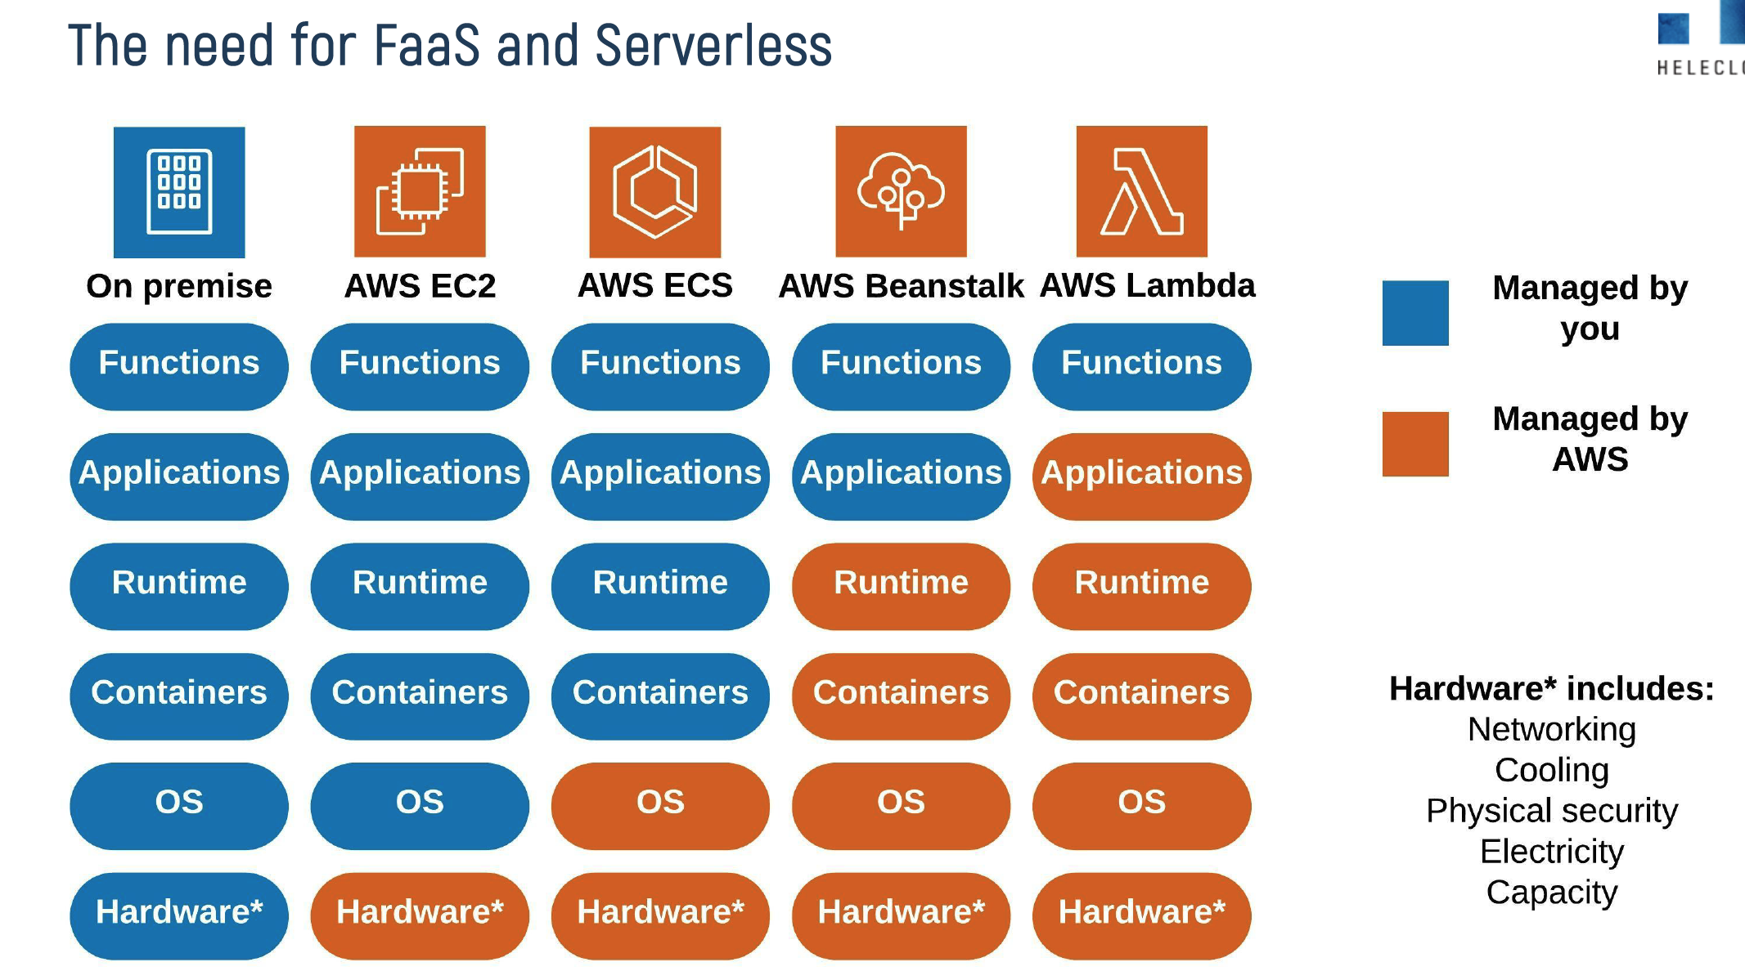
Serverless
Caption

Slide 5
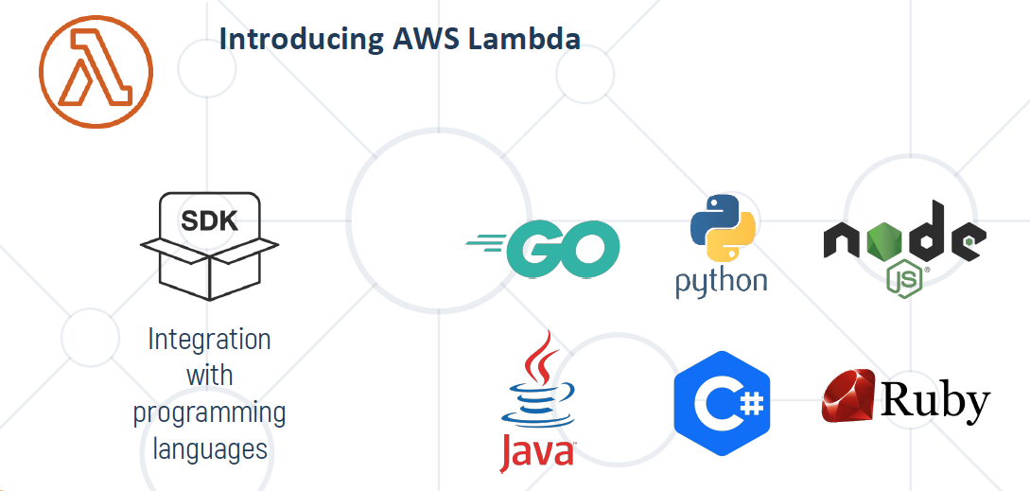
AWS Lambda
Caption

Slide 6
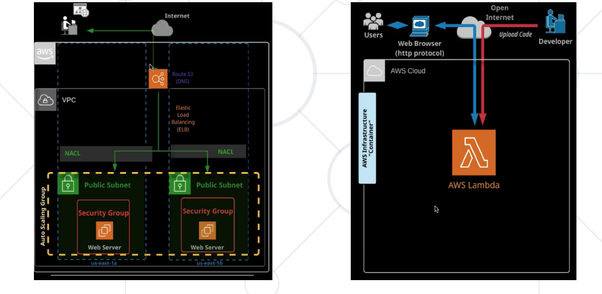
EC2/Lambda
Caption

Slide 7
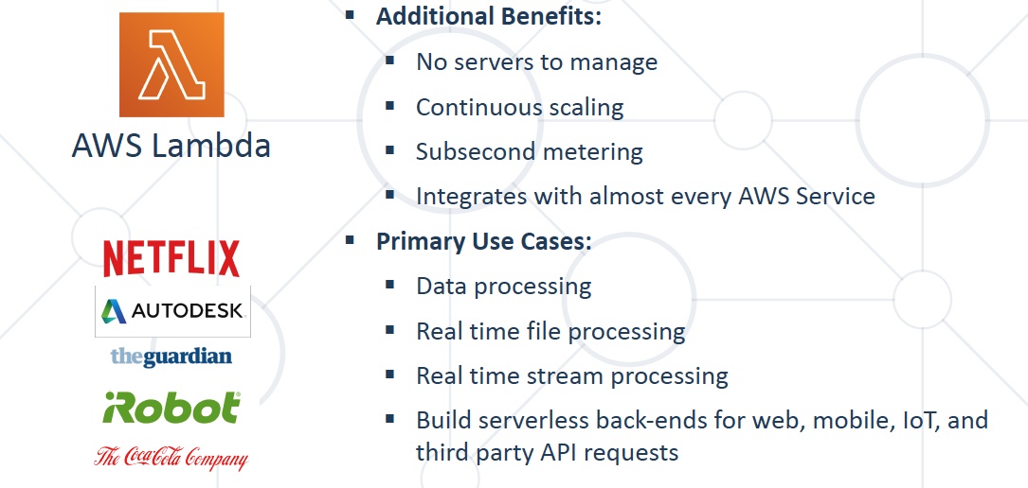
Lambda Benefits

Slide 8
Questions?

Slide 9











SoftUni Diamond Partners

Slide 10



Educational Partners

Slide 11
Trainings @ Software University (SoftUni)
Software University – High-Quality Education, Profession and Job for Software Developers
softuni.bg, about.softuni.bg
Software University Foundation
softuni.foundation
Software University @ Facebook
facebook.com/SoftwareUniversity
Software University Forums
forum.softuni.bg

Slide 12

License
This course (slides, examples, demos, exercises, homework, documents, videos and other assets) is copyrighted content
Unauthorized copy, reproduction or use is illegal
© SoftUni – https://about.softuni.bg/
© Software University – https://softuni.bg

